Slide 1


UNIVERSITY INSTITUTE OF ENGINEERING
COMPUTER SCIENCE & ENGINEERING
Introduction to Information Security
(Subject Code:20CST-354/ITT-354)
Prepared By : Er. Puneet kaur(E6913)
INTRODUCTION
DISCOVER . LEARN . EMPOWER

Slide 2
(RSA Algorithm & Diffie Hellman Algorithm)

Slide 3
RSA Algorithm
Developed in 1977 by Ron Rivest, Adi Shamir, and Len Adleman at MIT and first published in 1978.
Most widely accepted and implemented general-purpose approach to public-key encryption.
The RSA scheme is a block cipher in which the plaintext and ciphertext are integers between 0 and n - 1 for some n.

Slide 4
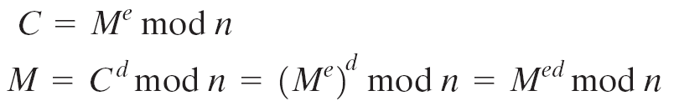
RSA Algorithm
RSA makes use of an expression with exponentials.
Both sender and receiver must know the value of n.
For some plaintext block M and ciphertext block C:

Slide 5
RSA Algorithm
Sender knows the value of e.
Only receiver knows the value of d.
Thus, this is a public-key encryption algorithm with a public key of PU = {e, n} and a private key of PR = {d, n}

Slide 6
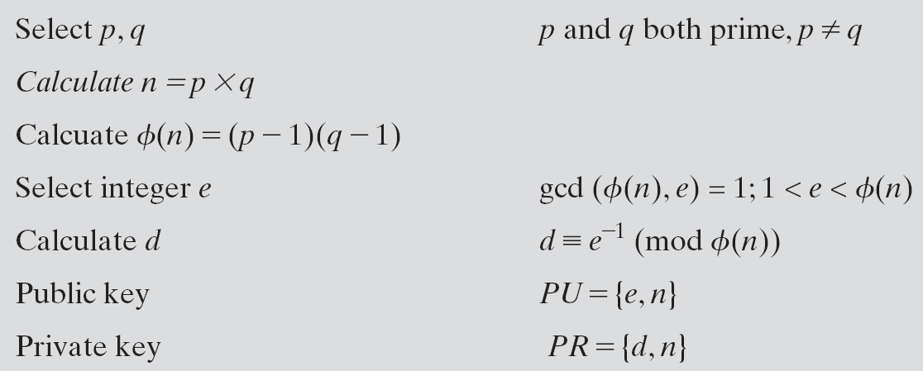
RSA Algorithm

Slide 7
RSA Algorithm
Example
Select two prime numbers p = 17 and q = 11
Calculate n = p x q = 17 × 11 = 187
Calculate Φ(n) = (p - 1) (q - 1) = 16 × 10 = 160
Select e such that e is relatively prime to Φ(n) = 160 and less than Φ(n); we choose e = 7

Slide 8
RSA Algorithm
Determine d such that de ≡ 1 (mod 160) and d < 160.
The correct value is d = 23
because 23 × 7 = 161 = (1 × 160) + 1;
d can be calculated using the extended Euclid’s algorithm.
The resulting keys are:
Public key PU = {7, 187}
Private key PR = {23, 187}.

Slide 9
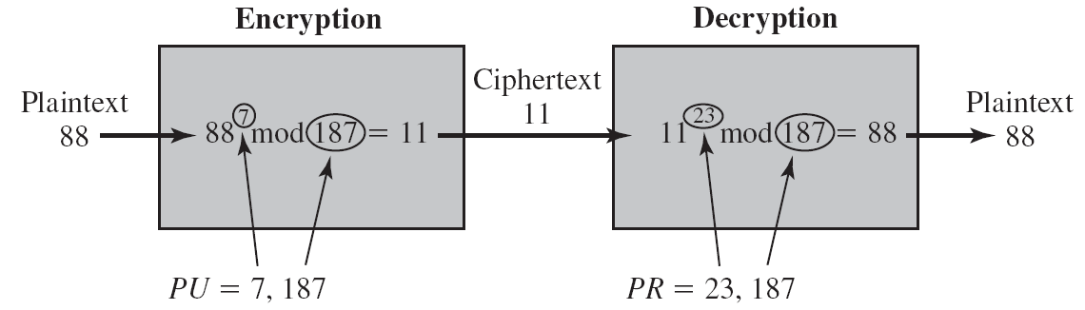
RSA Algorithm
M = 88
C = 88⁷ mod 187
= (88⁴ mod 187) x (88² mod 187) x (88¹ mod 187)
= 11

Slide 10
Requirements of RSA Algorithm
It is possible to find values of e, d, n such that
M^{ed} mod n = M for all M < n.
It is relatively easy to calculate Me mod n and C^{d} mod n for all values of M < n.
It is infeasible to determine d given e and n.

Slide 11
Security of RSA Algorithm
Four possible approaches to attacking the RSA algorithm are
Brute force attack
Involves trying all possible private keys.
Defense against the brute-force approach is to use a large key space. Thus, the larger the number of bits in d.
key generation and encryption/decryption, are complex.
The larger the size of the key, the slower the system will run.

Slide 12
Security of RSA Algorithm
Mathematical attacks
Effort to factoring the product of two primes.
Timing attacks
These depend on the running time of the decryption algorithm.
Chosen ciphertext attacks
This type of attack exploits properties of the RSA algorithm.

Slide 13
Diffie-Hellman Algorithm
Elliptic Curve Cryptography (ECC)
is a planar algebraic curve defined by an equation of the form
Y²=X³+ax+b
Where ‘a’ is the co-efficient of x and ‘b’ is the constant of the equation

Slide 14
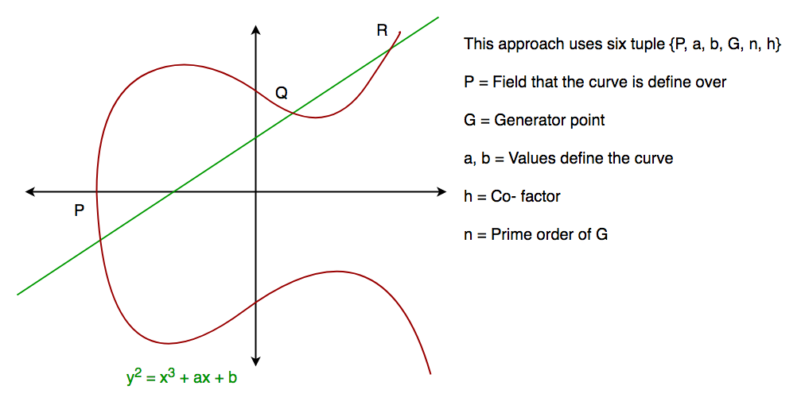
Elliptic Curve Cryptography (ECC)

Slide 15
Diffie-Hellman Algorithm
The Diffie-Hellman algorithm is being used to establish a shared secret communications while exchanging data over a public network.
the elliptic curve is used to generate points and get the secret key using the parameters.
For practical implementation of the algorithm, we will consider only 4 variables one prime P and G (a primitive root of P) and two private values a and b.

Slide 16
Diffie-Hellman Algorithm
Step by Step Explanation
Alice | Bob
Public Keys available = P, G | Public Keys available = P, G
Private Key Selected = a | Private Key Selected = b
Key generated = x= Ga mod P | Key generated = y= G^{b} mod P

Slide 17
Diffie-Hellman Algorithm
Exchange of generated keys takes place
Key received = y Key received = x
Generated Secret Key = Generated Secret Key =
k_{a} = yªmod P k_{b}= x^{b}mod P
Algebraically it can be shown that k_{a}=k_{b}

Slide 18
Diffie-Hellman Algorithm
Example
Step 1: Alice and Bob get public numbers P = 23, G = 9
Step 2: Alice selected a private key a = 4 and
Bob selected a private key b = 3
Step 3: Alice and Bob compute public values
Alice: x =(9^4 mod 23) = (6561 mod 23) = 6 Bob: y = (9^3 mod 23) = (729 mod 23) = 16

Slide 19
Diffie-Hellman Algorithm
Step 4: Alice and Bob exchange public numbers
Step 5: Alice receives public key y =16 and
Bob receives public key x = 6
Step 6: Alice and Bob compute symmetric keys
Alice: ka = y^a mod p = 65536 mod 23 = 9 Bob: kb = x^b mod p = 216 mod 23 = 9
Step 7: 9 is the shared secret.

Slide 20
References
http://www.brainkart.com/article/Classical-Encryption-Techniques_8339/
https://www.tutorialspoint.com/cryptography/index.htm
https://www.geeksforgeeks.org/cryptography-introduction/
https://www.techopedia.com/definition/1770/cryptography#:~:text=Cryptography%20involves%20creating%20written%20or,information%20to%20be%20kept%20secret.&text=Information%20security%20uses%20cryptography%20on,transit%20and%20while%20being%20stored.

Slide 21
References
https://www2.slideshare.net/lineking/classical-encryption-techniques-in-network-security?qid=e388c29f-793d-4f2b-bcaf-9d22e9ca07b5&v=&b=&from_search=1

Slide 22
E- Books Recommended
https://www.pdfdrive.com/cyber-security-books.html
https://bookauthority.org/books/new-cyber-security-ebooks
https://bookauthority.org/books/best-cyber-security-ebooks
https://www.freetechbooks.com/information-security-f52.html

